Slide 1
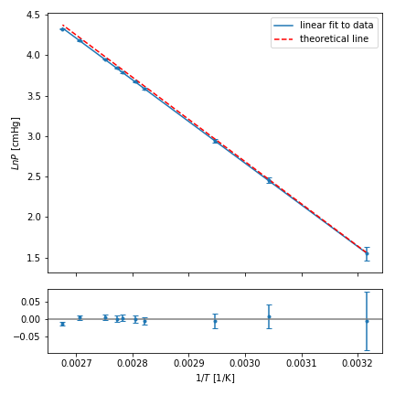
(a)
ln P [cmHg]
1/T [1/K]

Slide 2
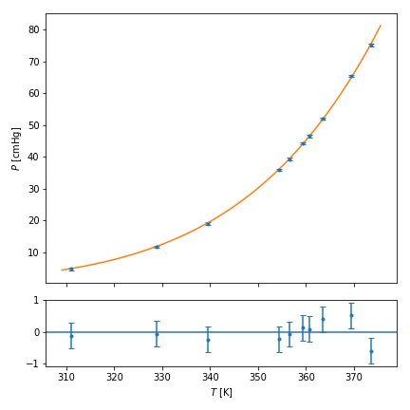
(b)
P [cmHg]
T [K]

